Slide 1
Project II
Scott Pastor

Slide 2
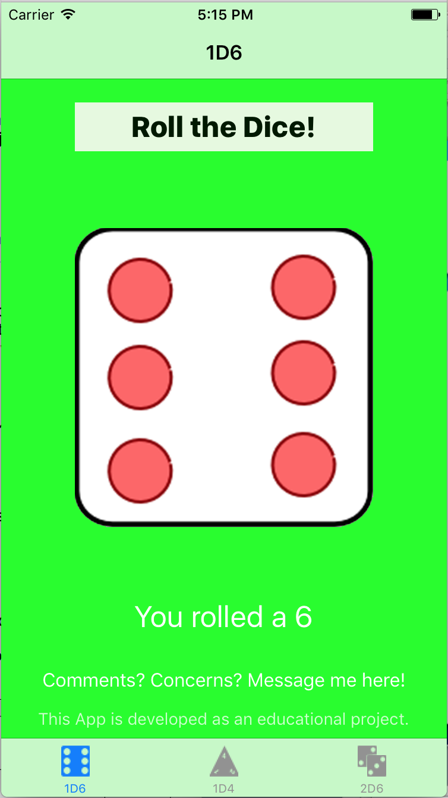
Dice Rolling App
My app is a simple program to roll different types of dice
My main audience is anyone who commonly plays board games, specifically games that involve multiple types of dice

Slide 3
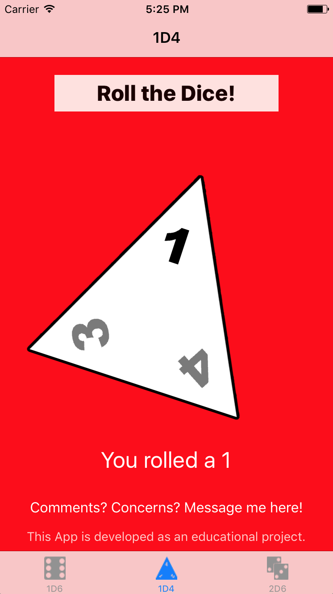
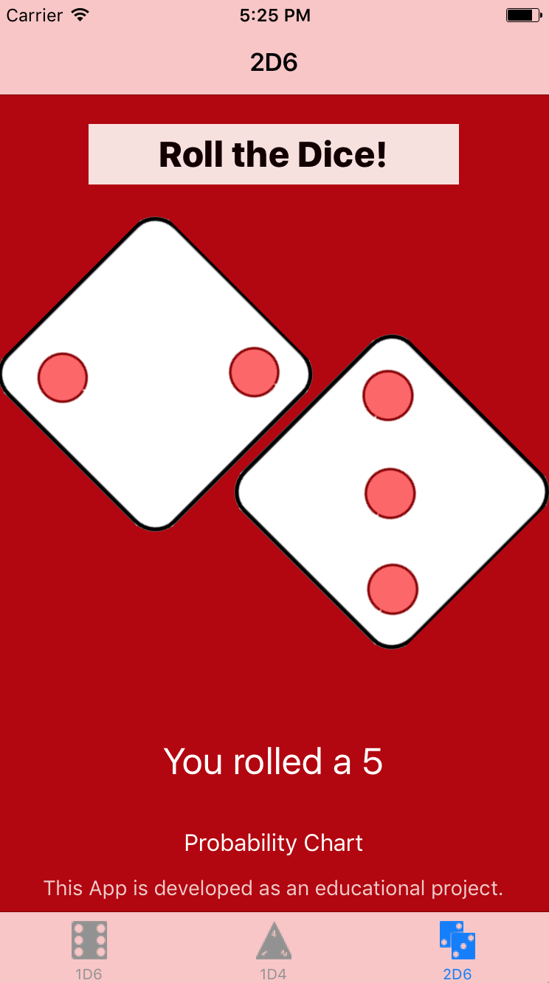
New Additions
A Four Sided Die
Two Six Sided Die

Slide 4
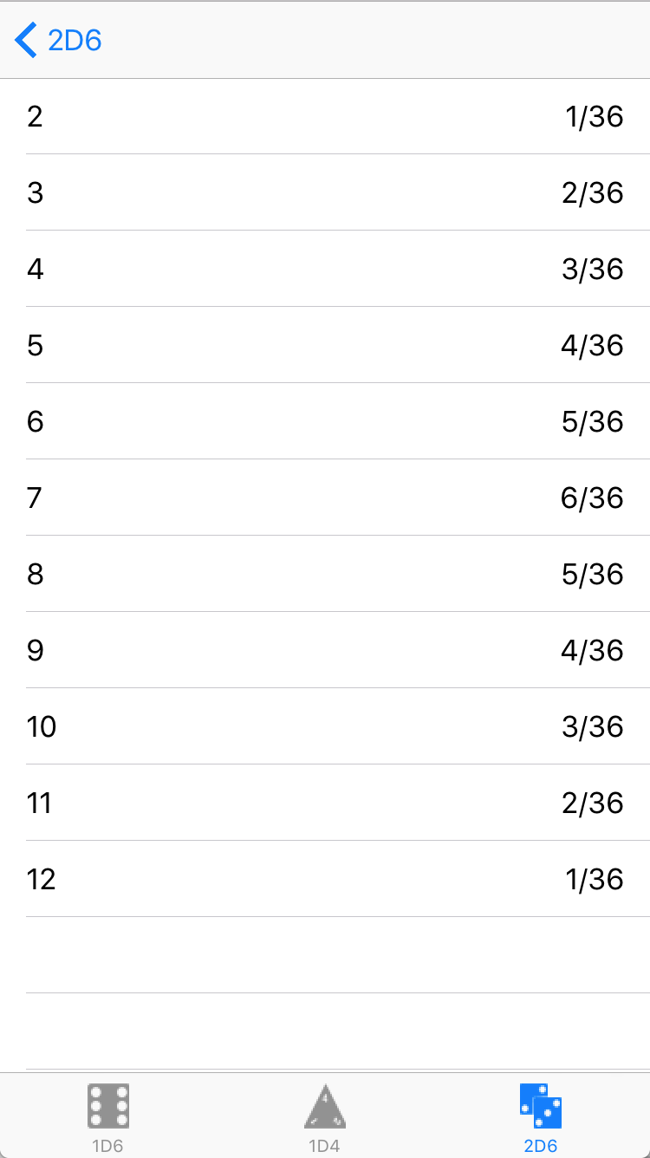
New Additions
Probability Chart Button Added
Probability of Each Roll Combination

Slide 5
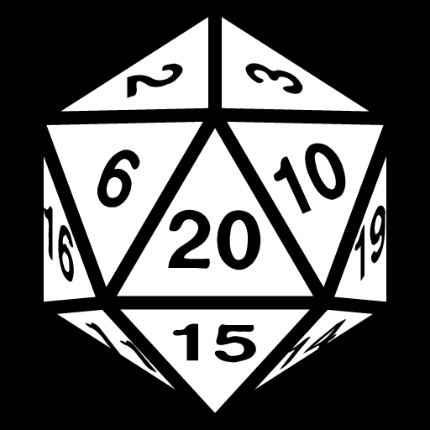
Challenges
I initially planned on adding several more types of dice
The creation of each face of a twenty sided die was too time consuming
JSON is a pain

Slide 6
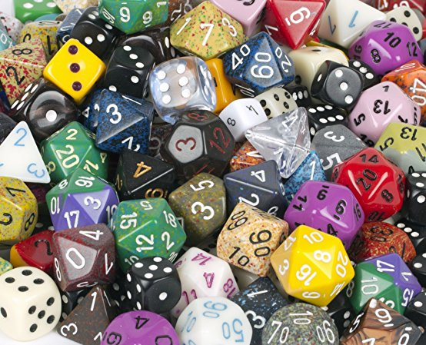
Next Step
Plan to add more dice types as soon as time allows
Would like to add the option to select how many dice are rolled at a time

Slide 7
Thank You

